Slide 1
R Shiny
Building Interactive Web Applications with R
Jeremy Buhler, Data librarian
Albina Gibadullina, Graduate academic assistant

Slide 2
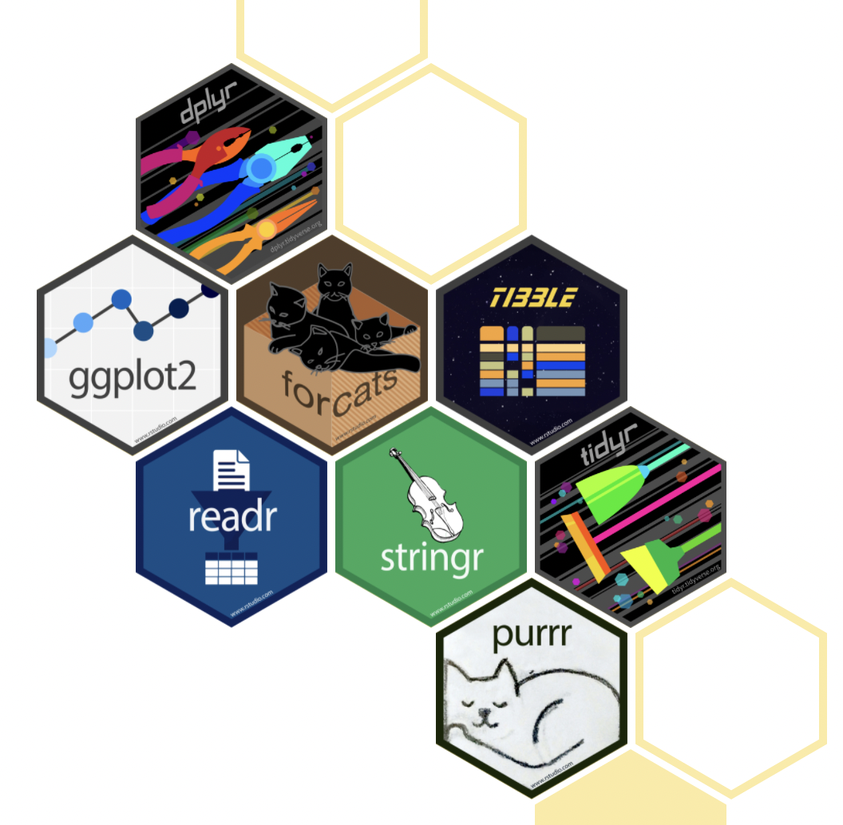
Workshop Prerequisites
Software requirements:
Have R installed
Have R Studio installed
Assumed prior knowledge:
Have some experience developing visualizations or manipulating data in R (e.g. knowledge of ggplot2 and dplyr)

Slide 3
Your Experience with R and Visualization
Experienced in visualization
New to R
Experienced in R
New to visualization

Slide 4
Learning objectives
Become familiar with shiny package for making web applications
Learn how to make a simple shiny app in R
Learn how to expand on your app with more advanced features

Slide 5
Introduction to shiny

Slide 6
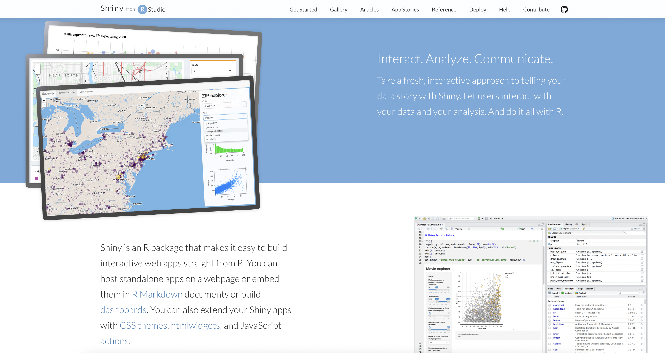
What is shiny?

Slide 7
What is shiny used for?
Developing interactive visualizations/tables (which can be incorporated on your website, in R markdown file, or in Tableau)
Developing data-oriented web applications
Developing full websites

Slide 8
Structure of a shiny app
UI
Specifying user inputs and user outputs
Server
Specifying how to construct outputs and do all calculations
Launch app
Run shinyApp(ui = ui, server = server)
Note: previously you would have two separate files: UI.r and server.r, now there is a combined app.R file

Slide 9
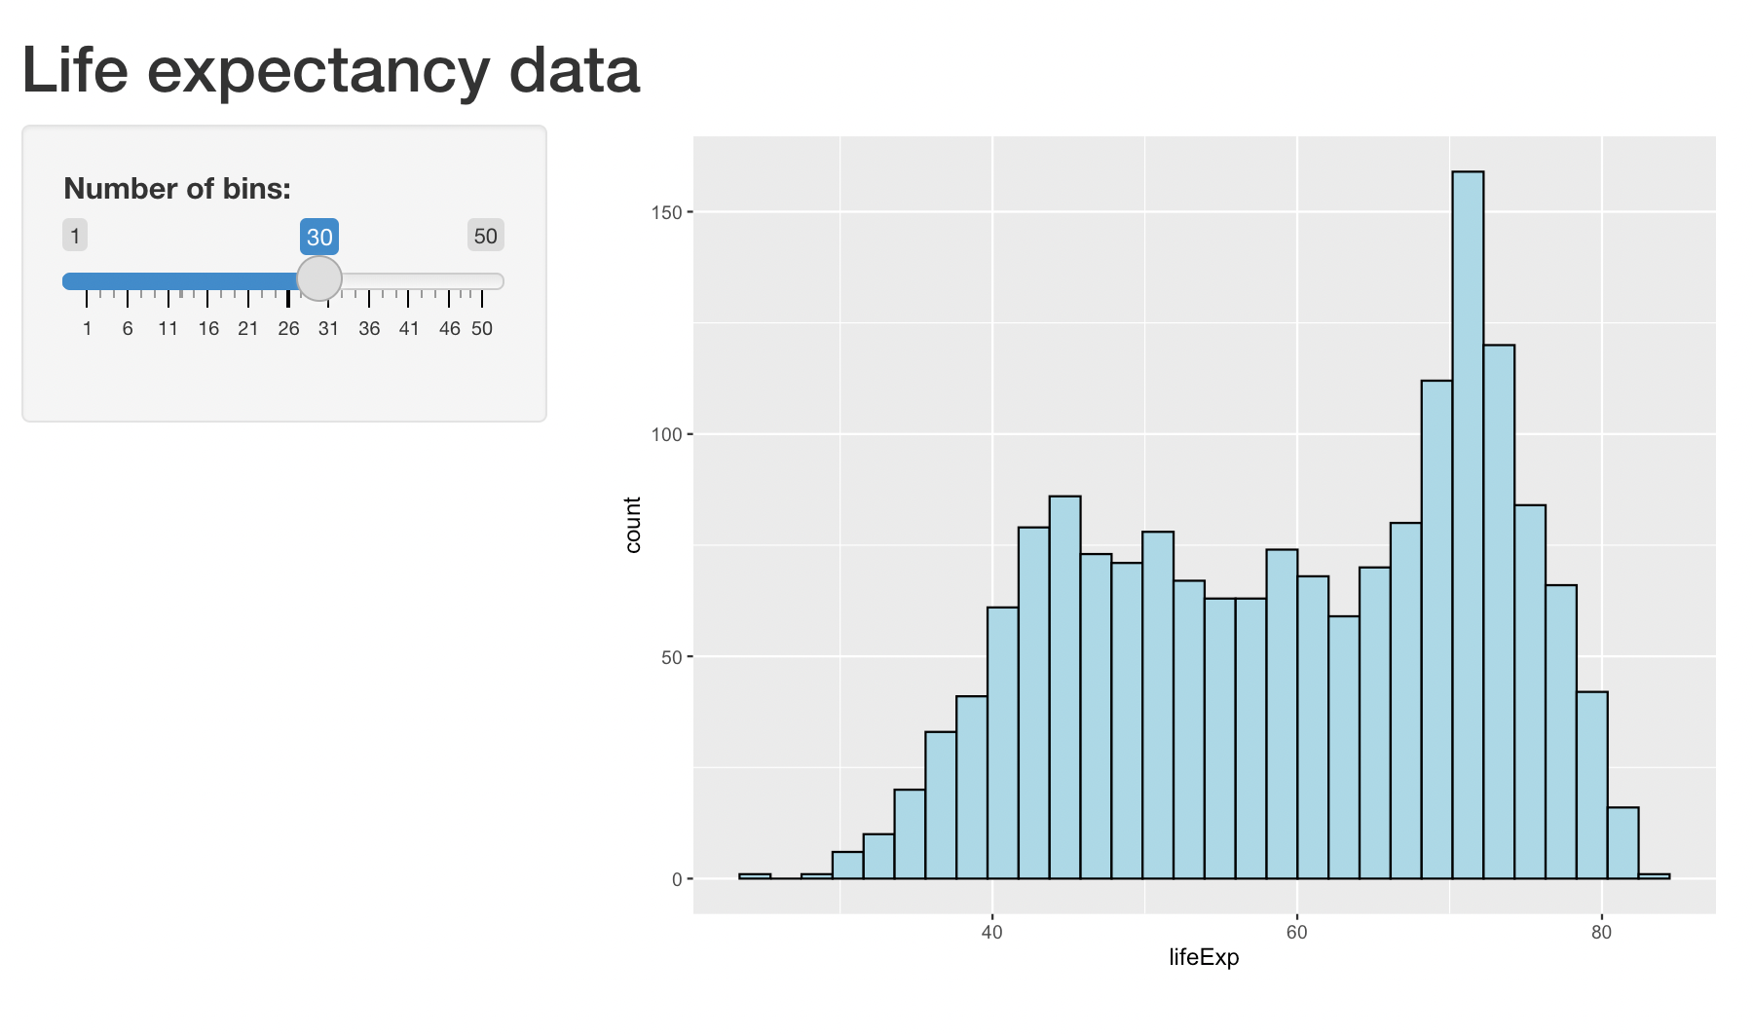
Time to see our first shiny app!

Slide 10
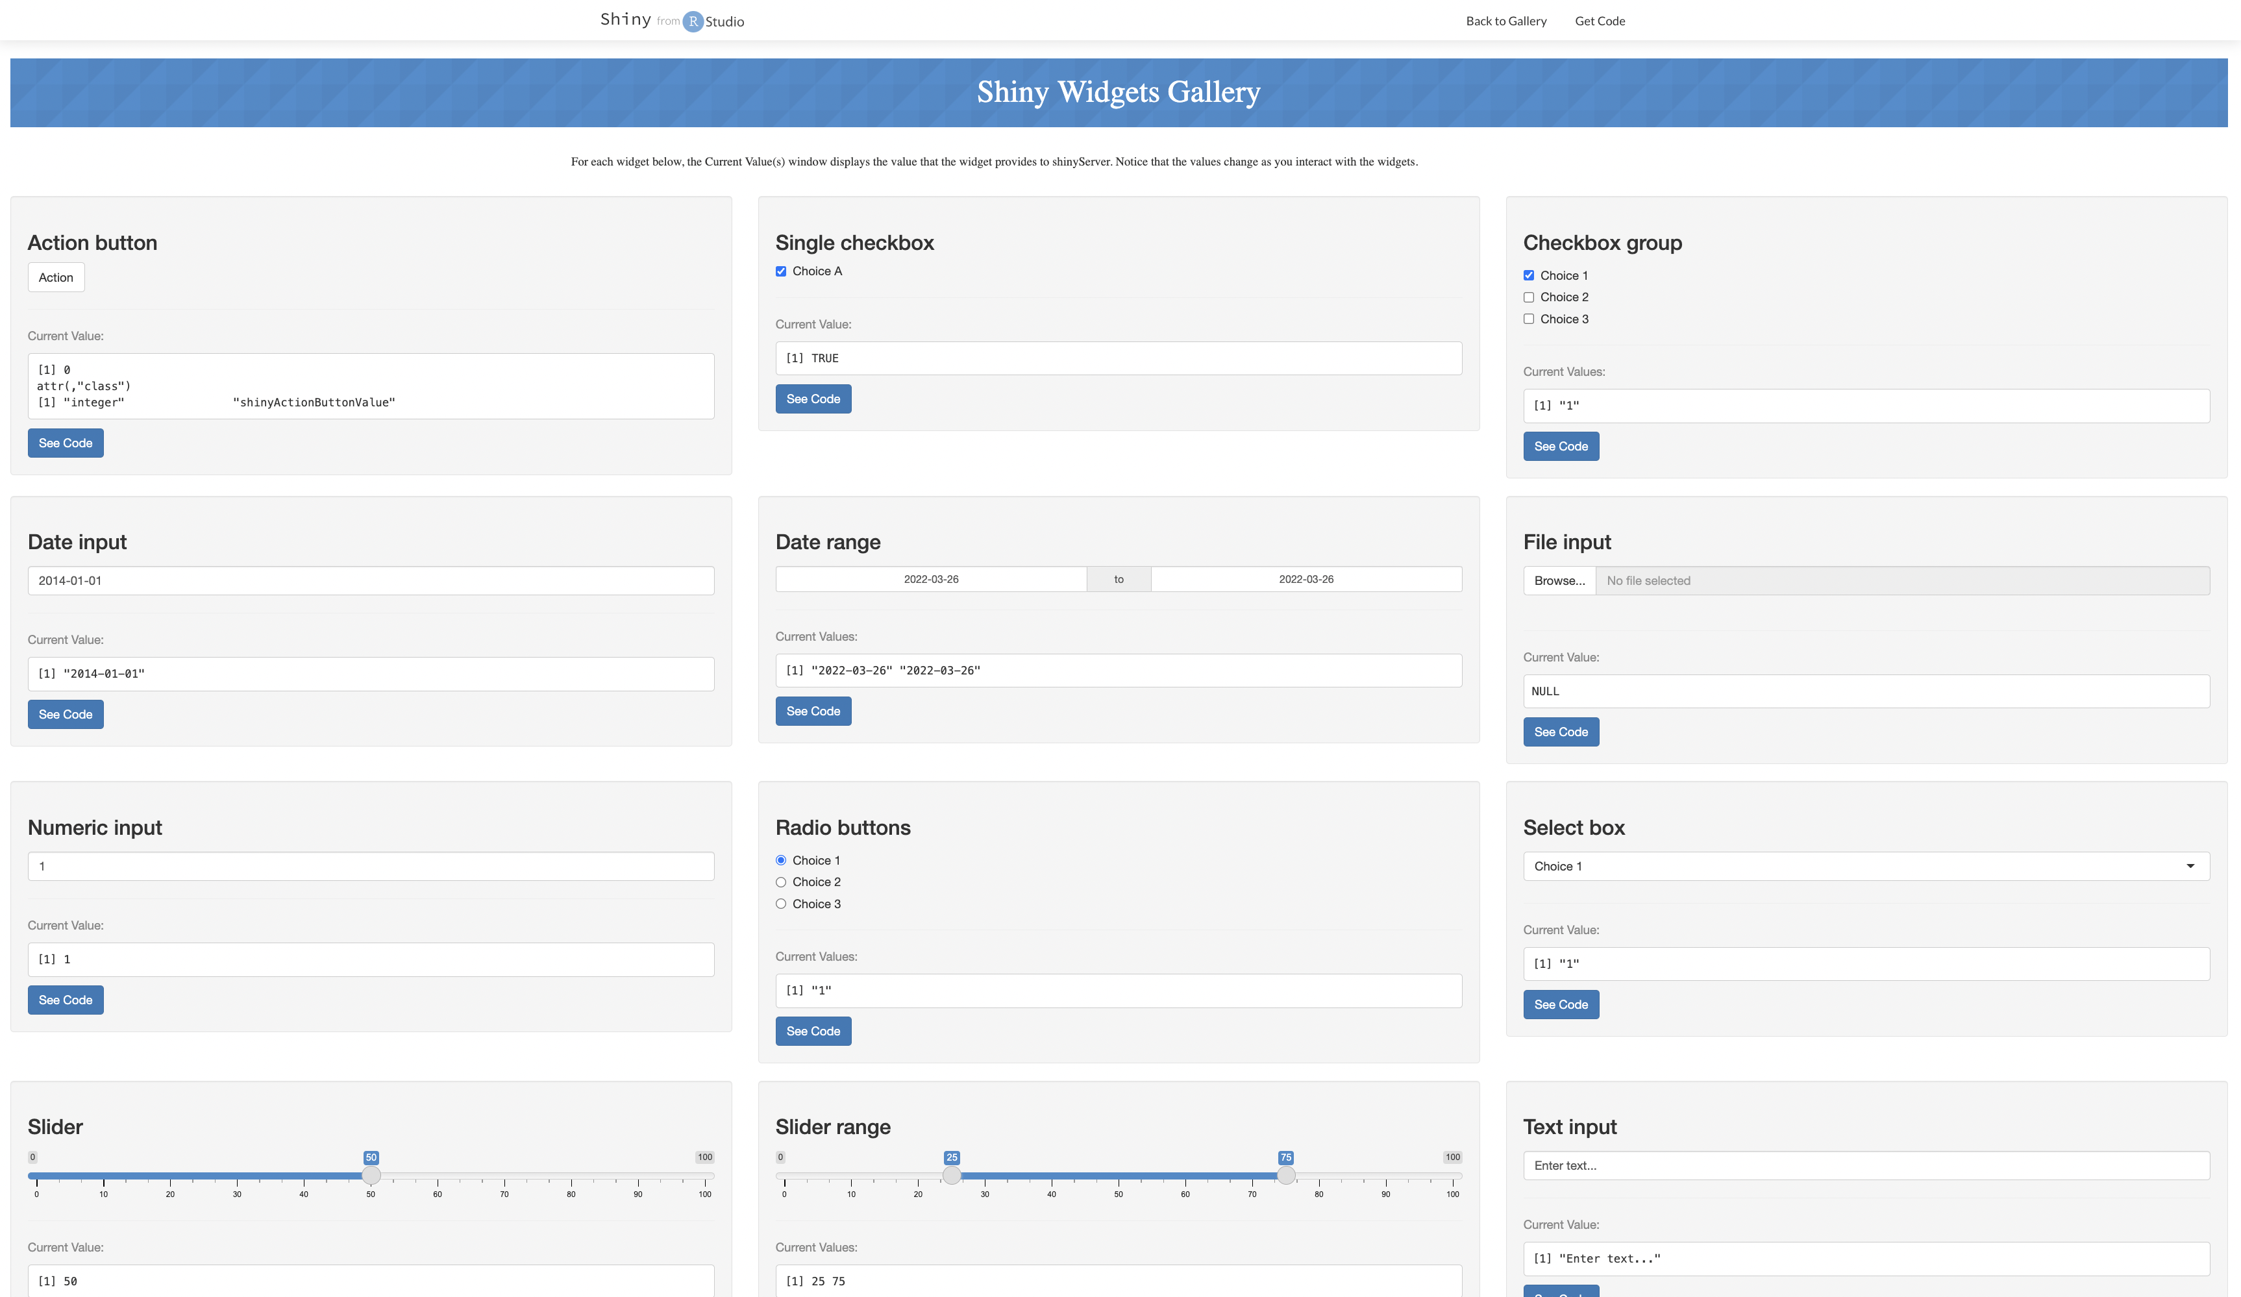

Slide 11
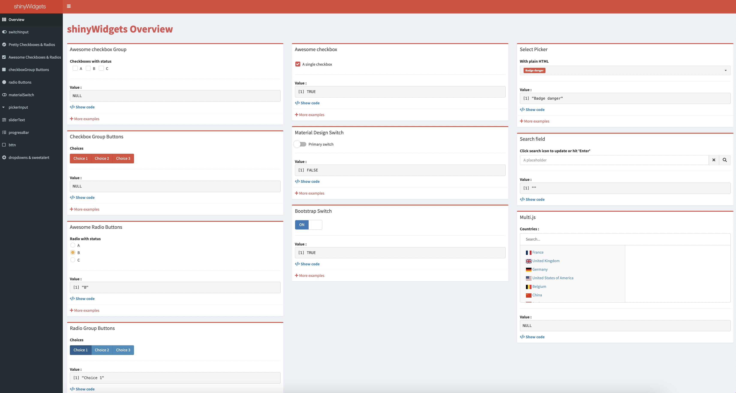
Additional widgets offered by shinywidgets

Slide 12
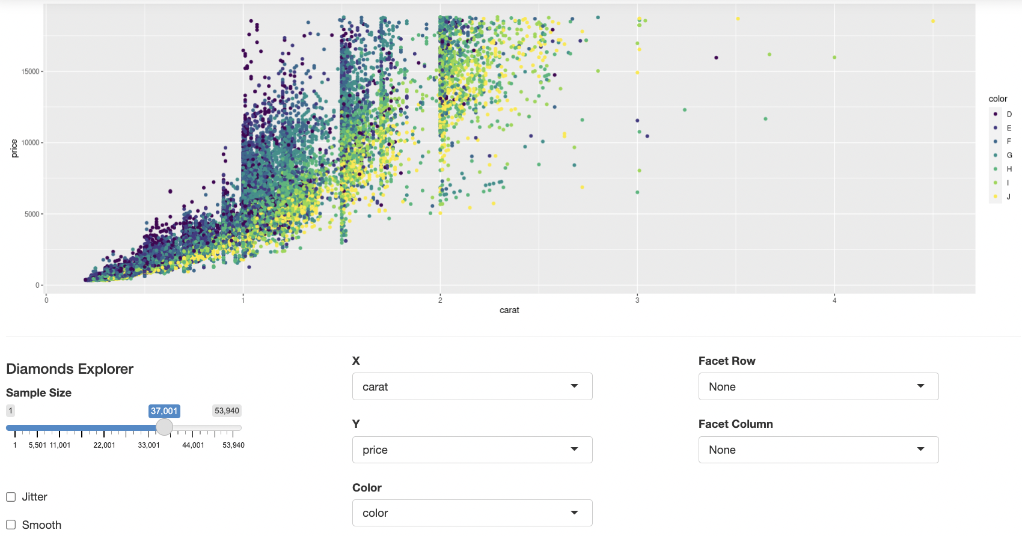
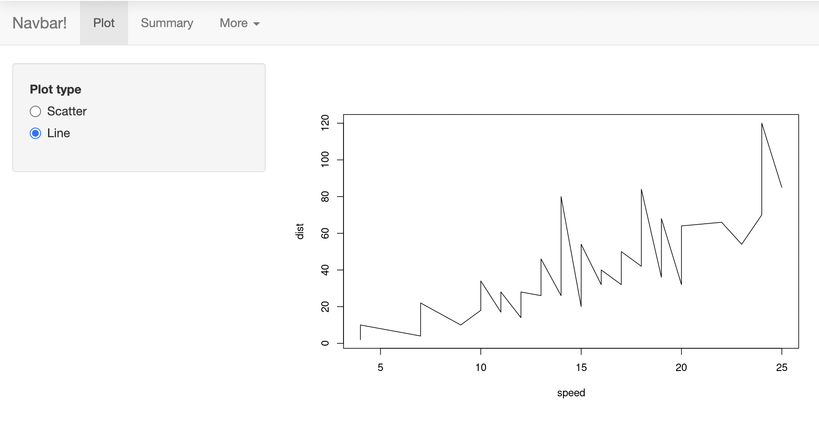
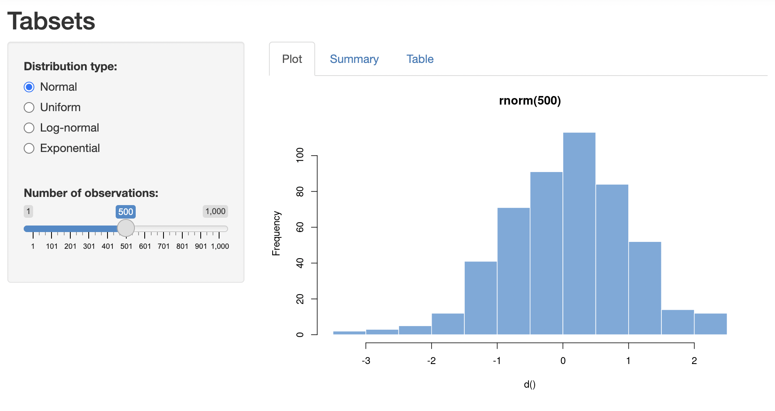
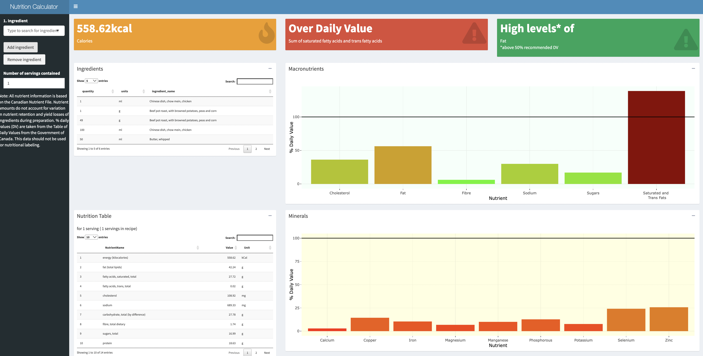
Four Application layouts
Horizontal/vertical layering
Tabsets
Navbar
ShinyDashboard

Slide 13
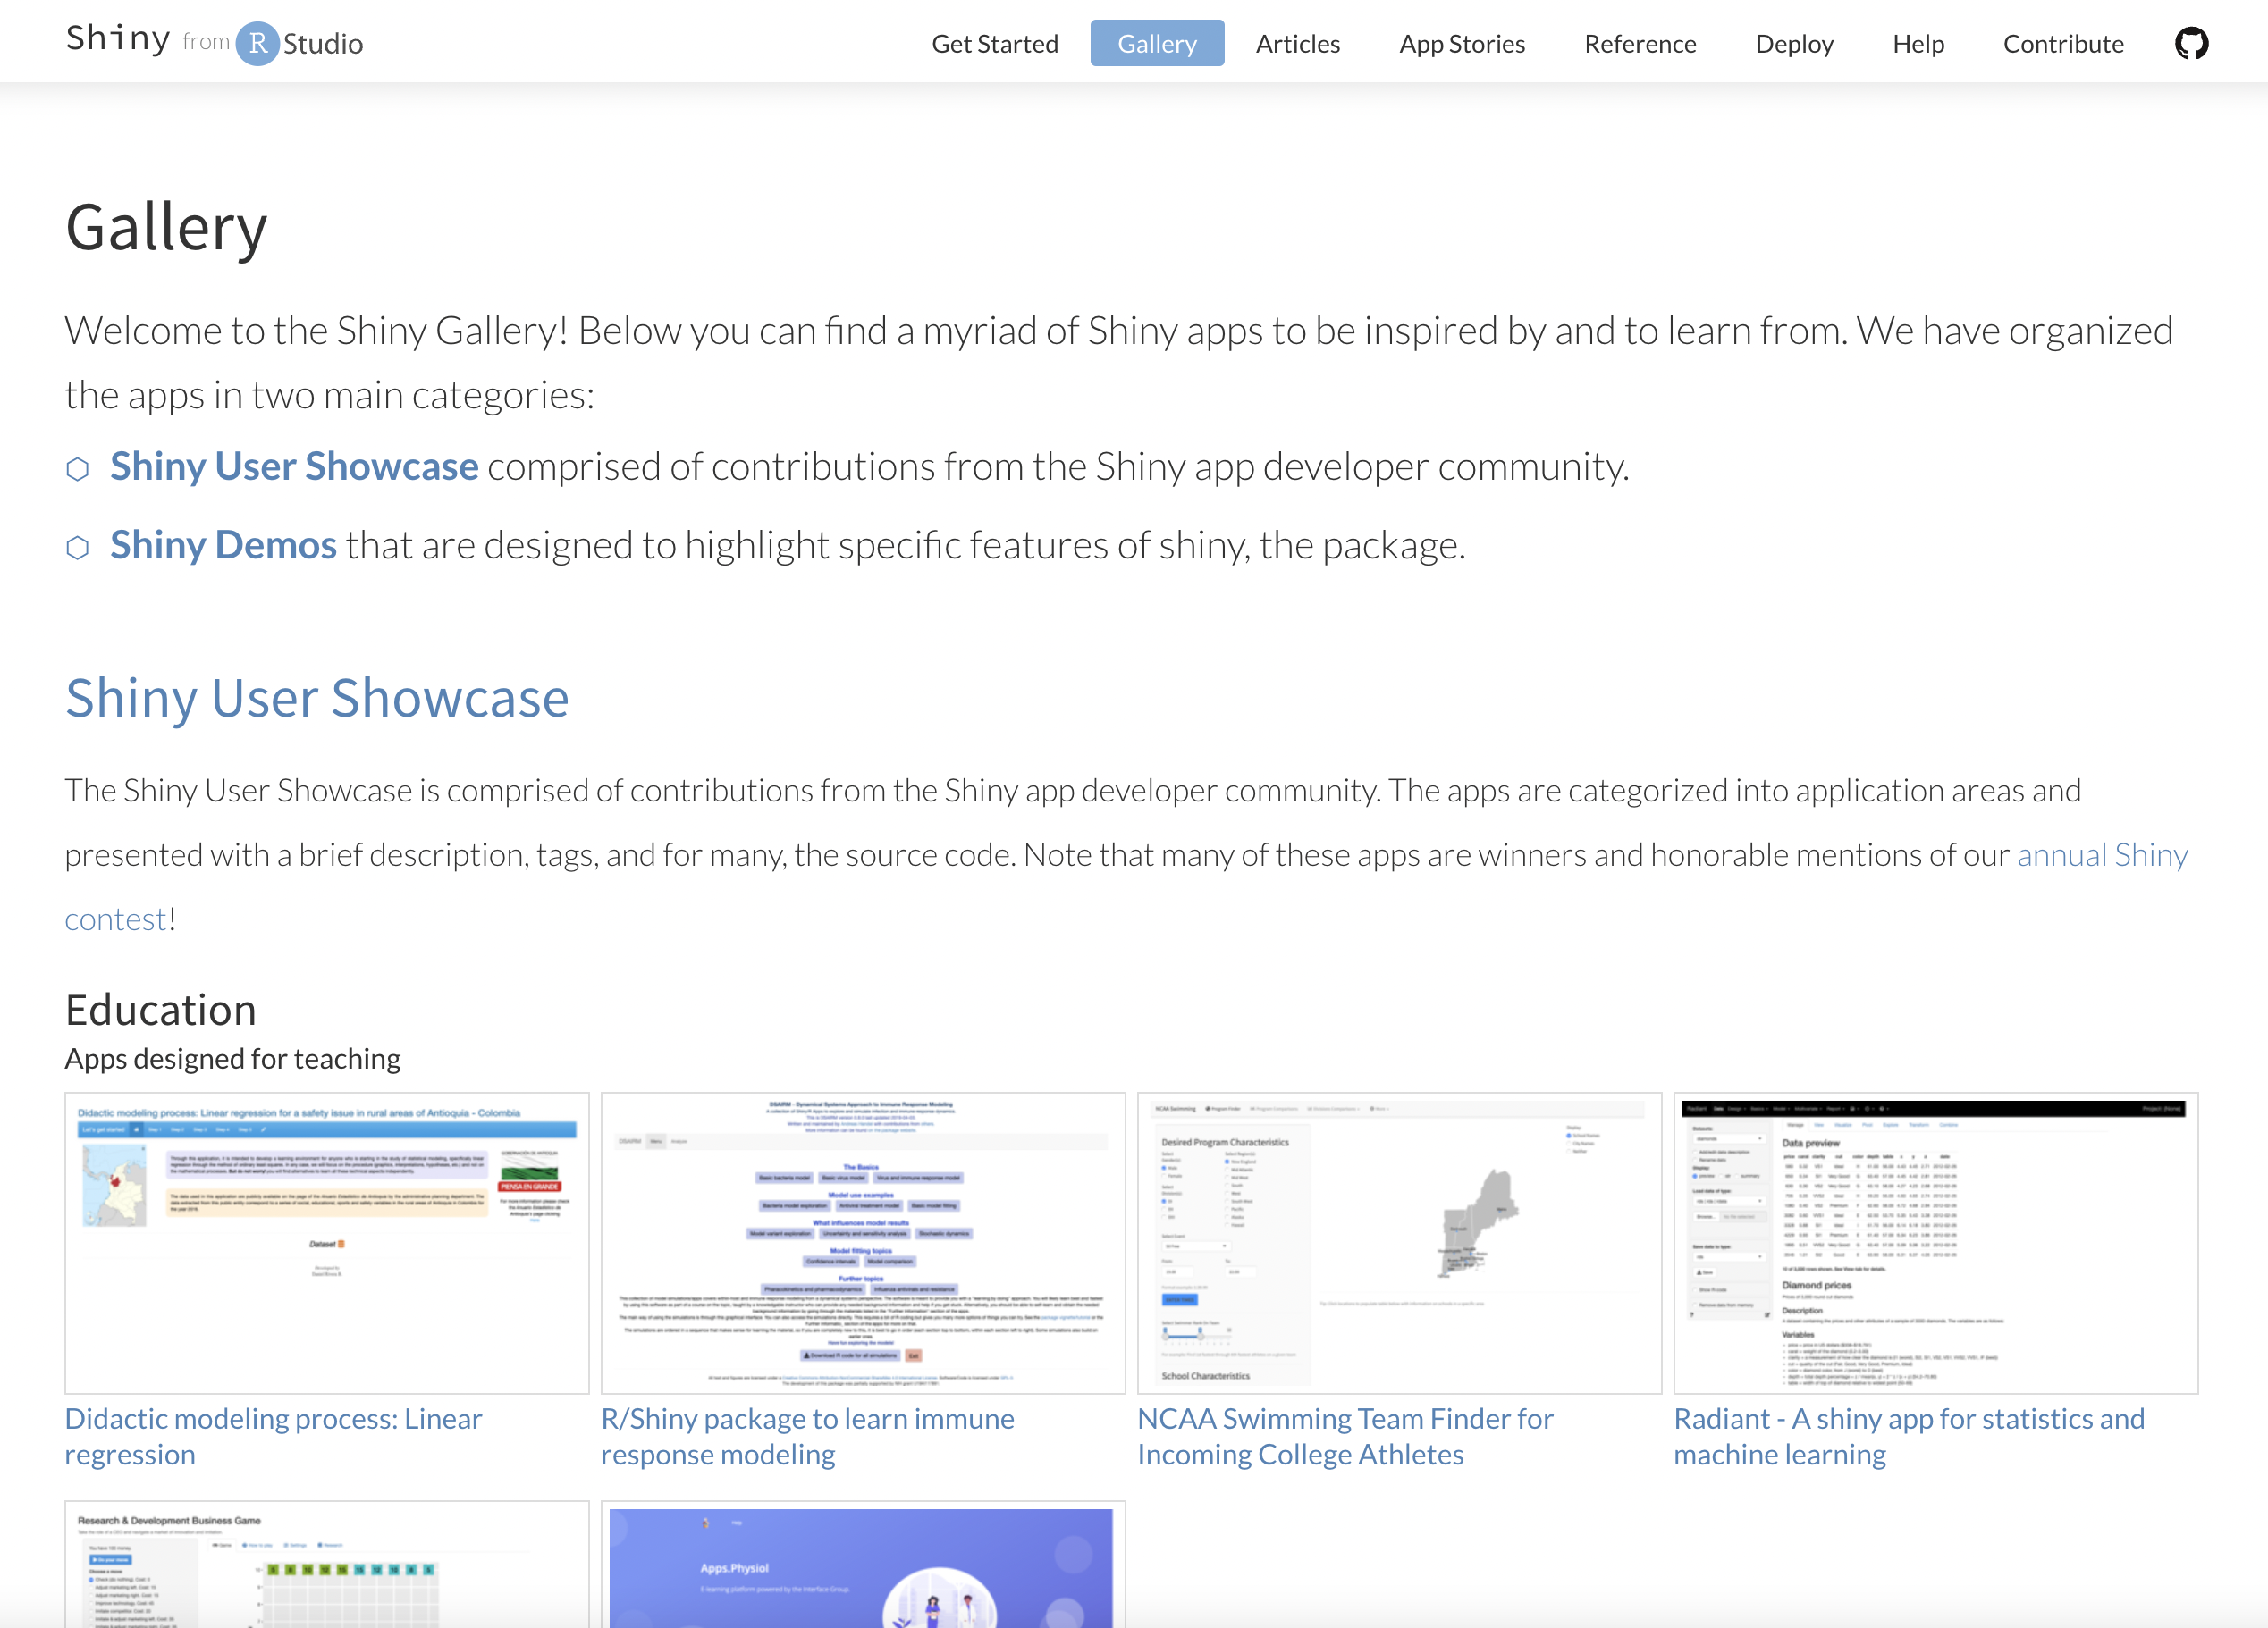

Slide 14
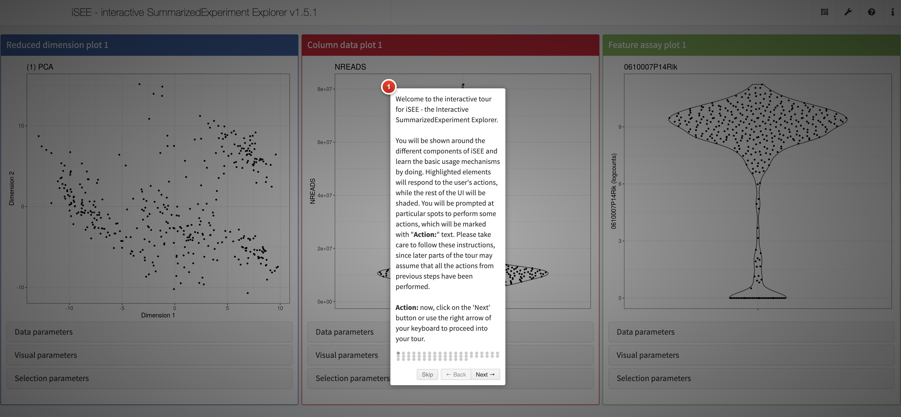
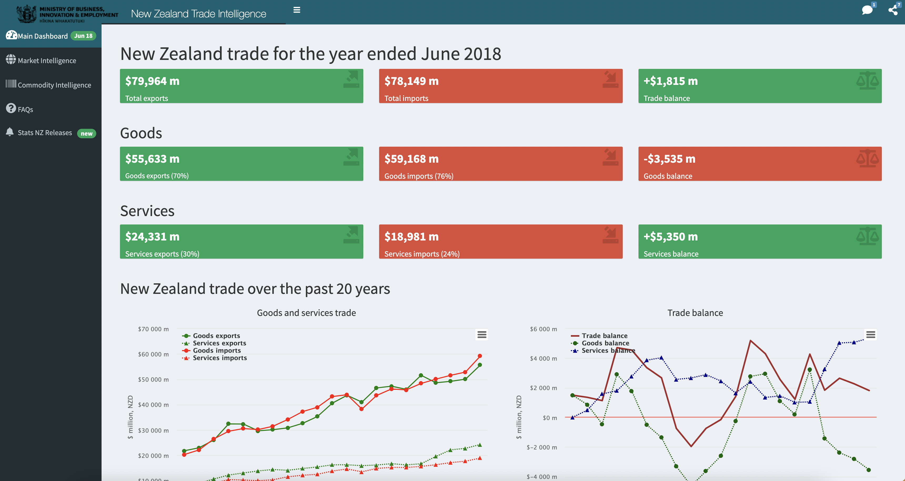
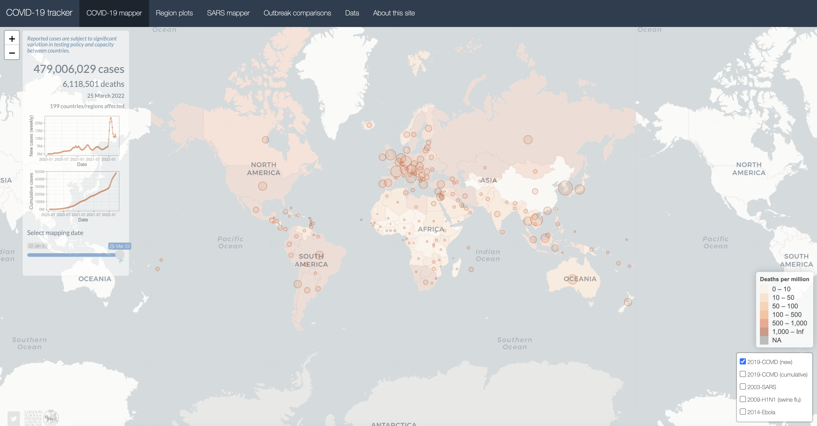
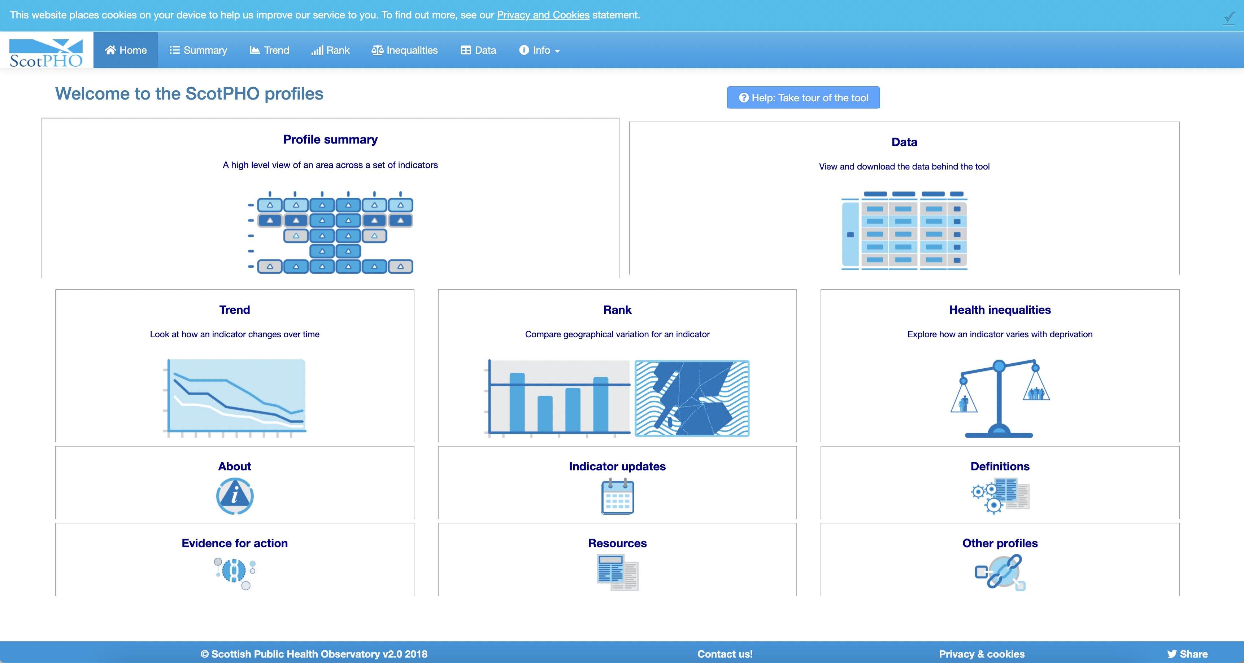
Shiny app Examples

Slide 15
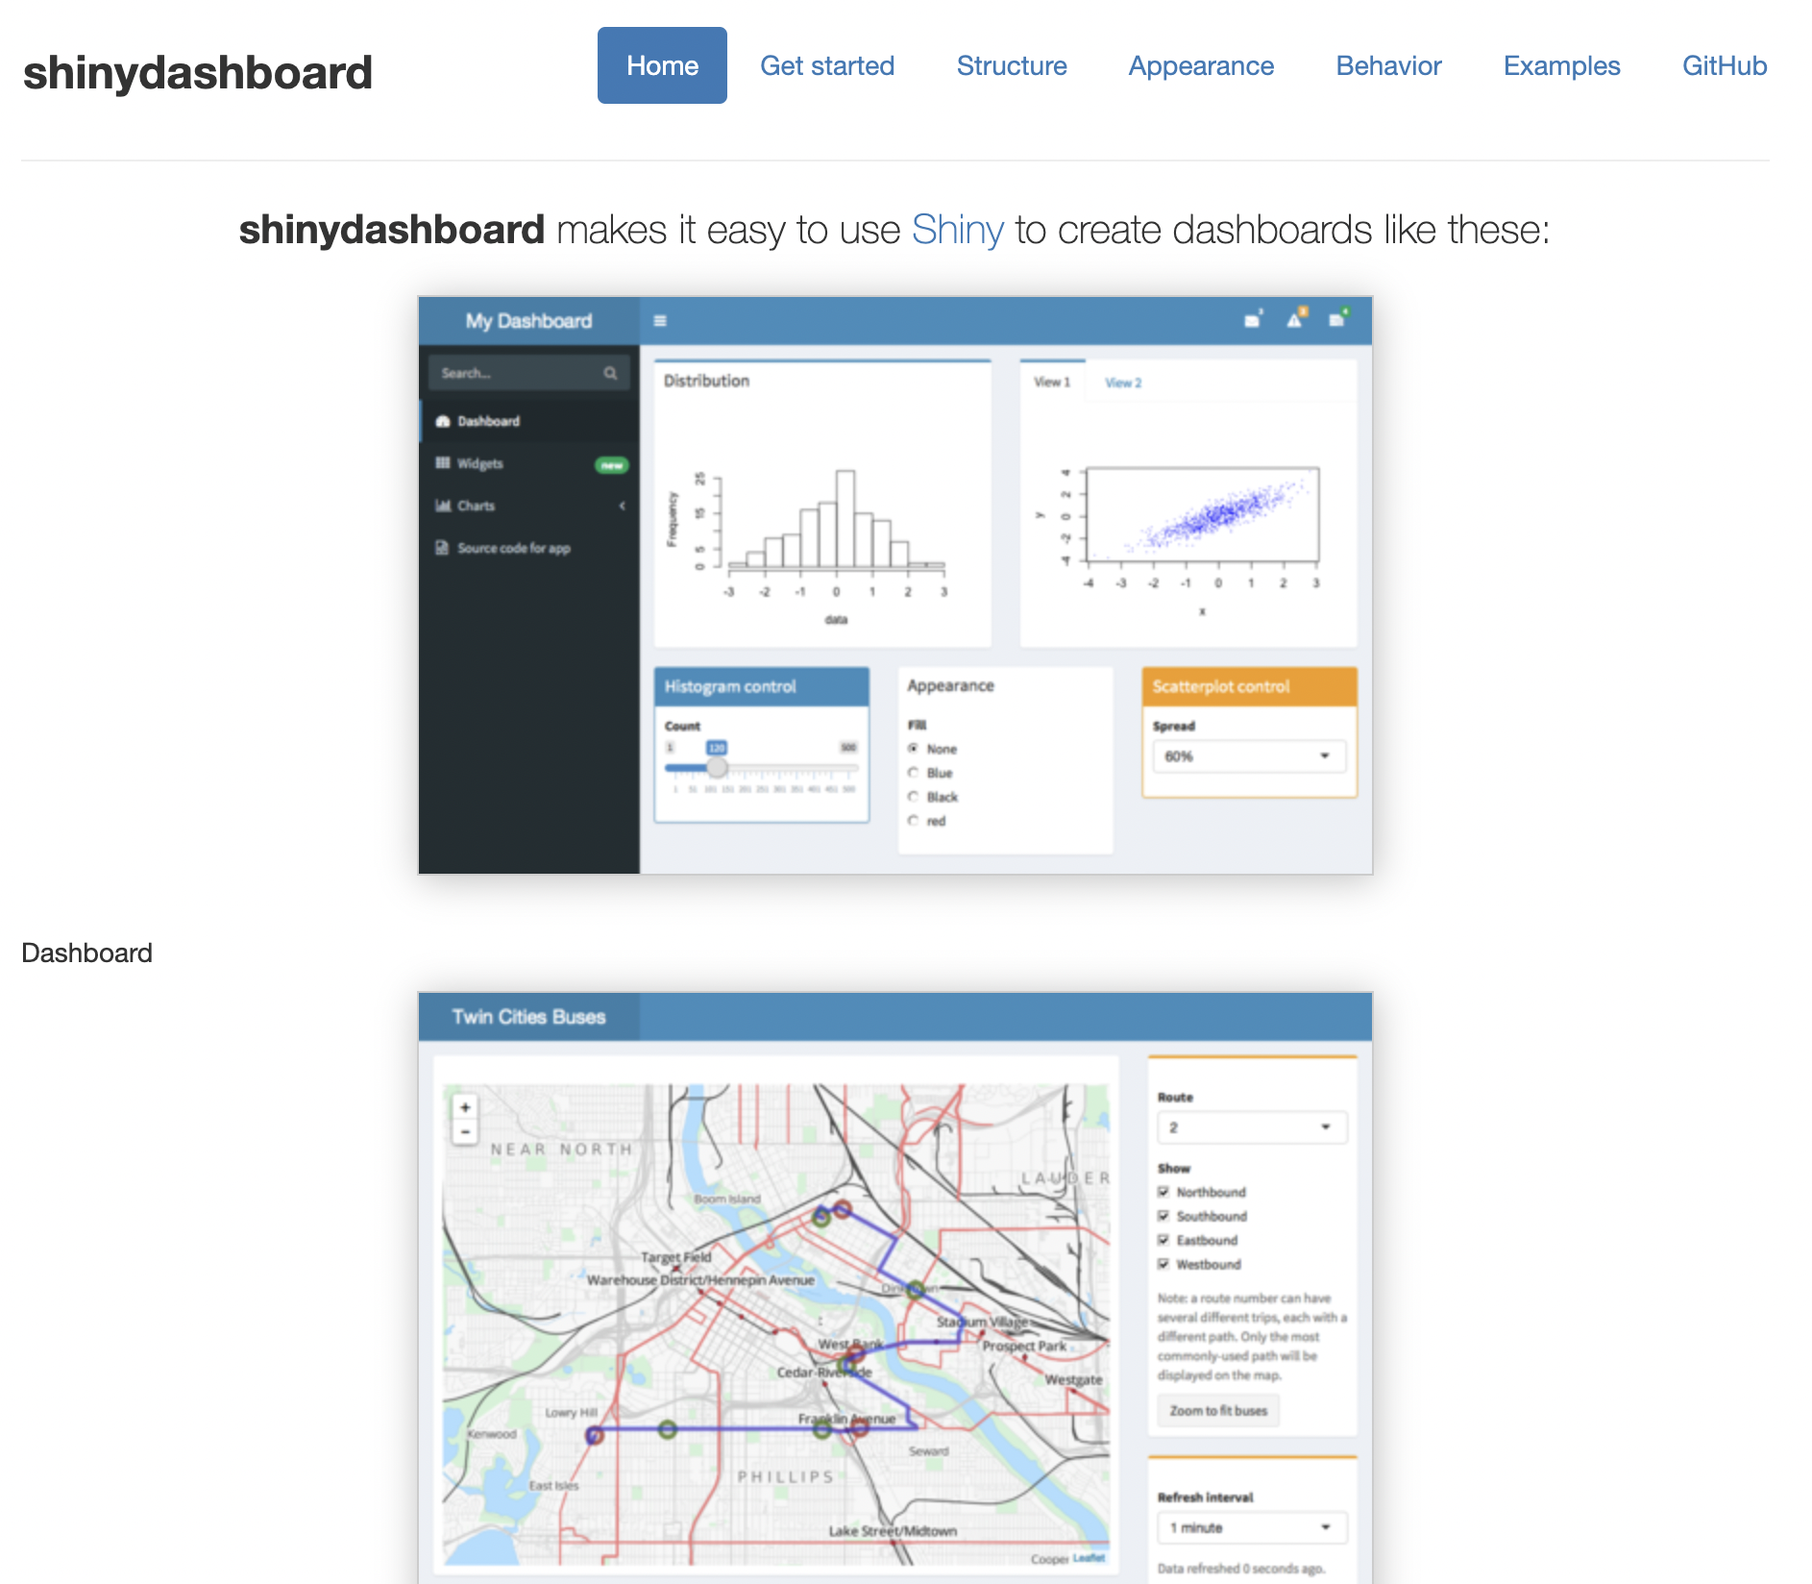
Modifying the app further
with
Shiny
dashboard

Slide 16
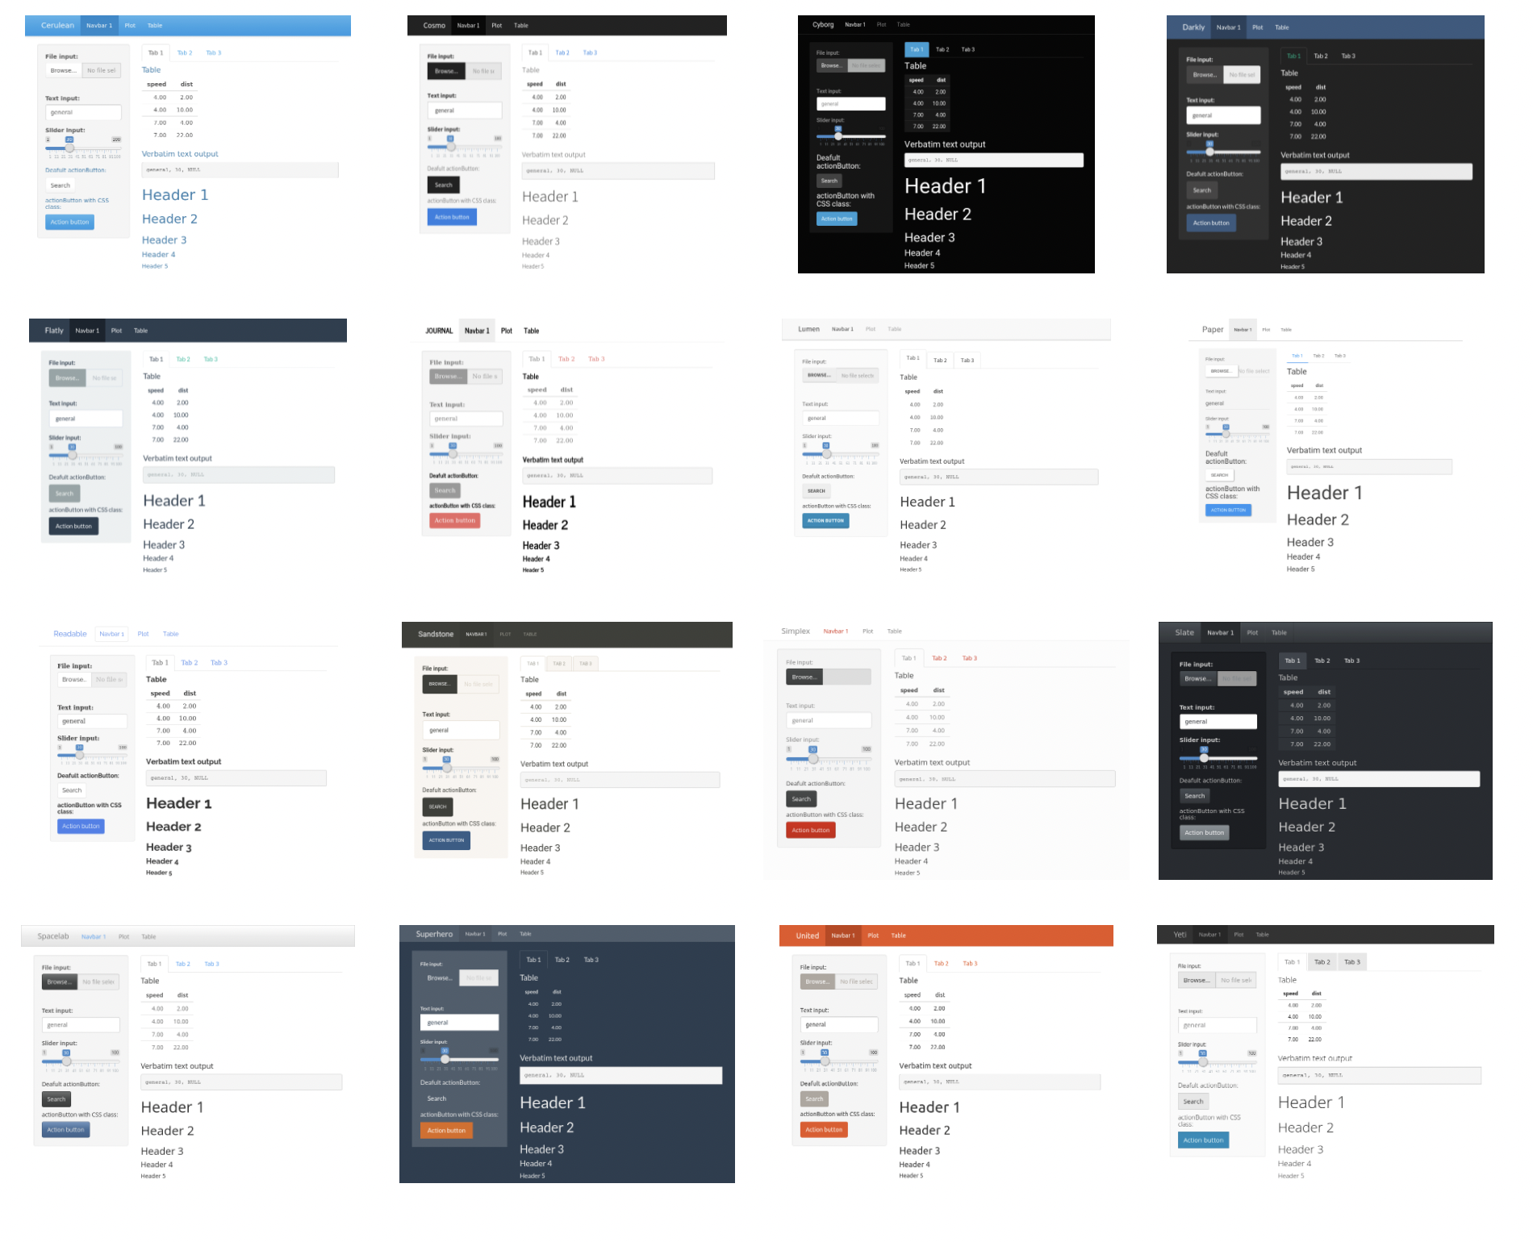
Modifying the app further
with
css
themes

Slide 17
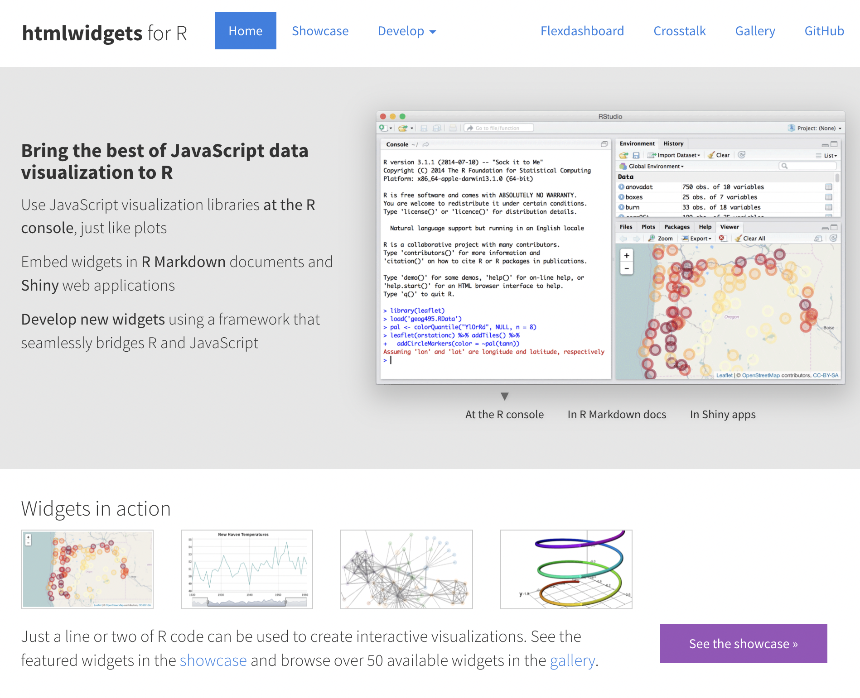
Modifying the app further
with
Html
widgets

Slide 18
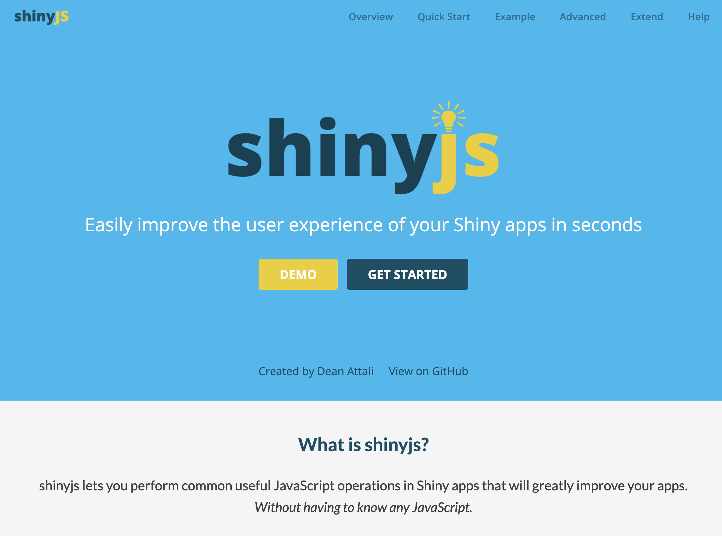
Modifying the app further
with
Java
script

Slide 19
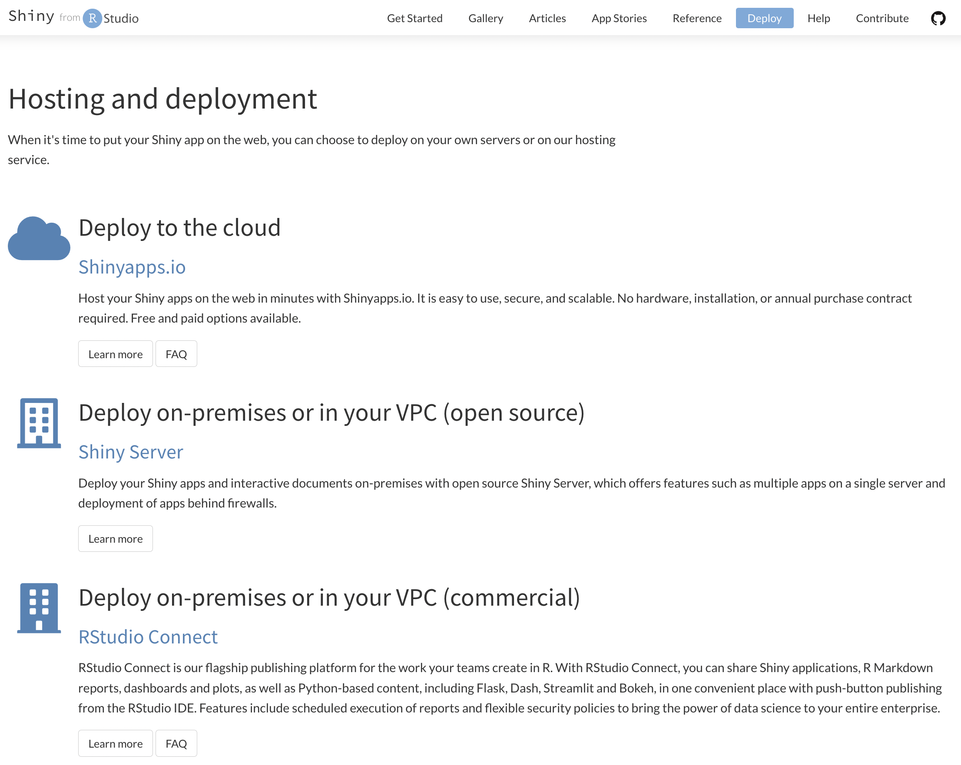
three ways to launch your shiny app

Slide 20
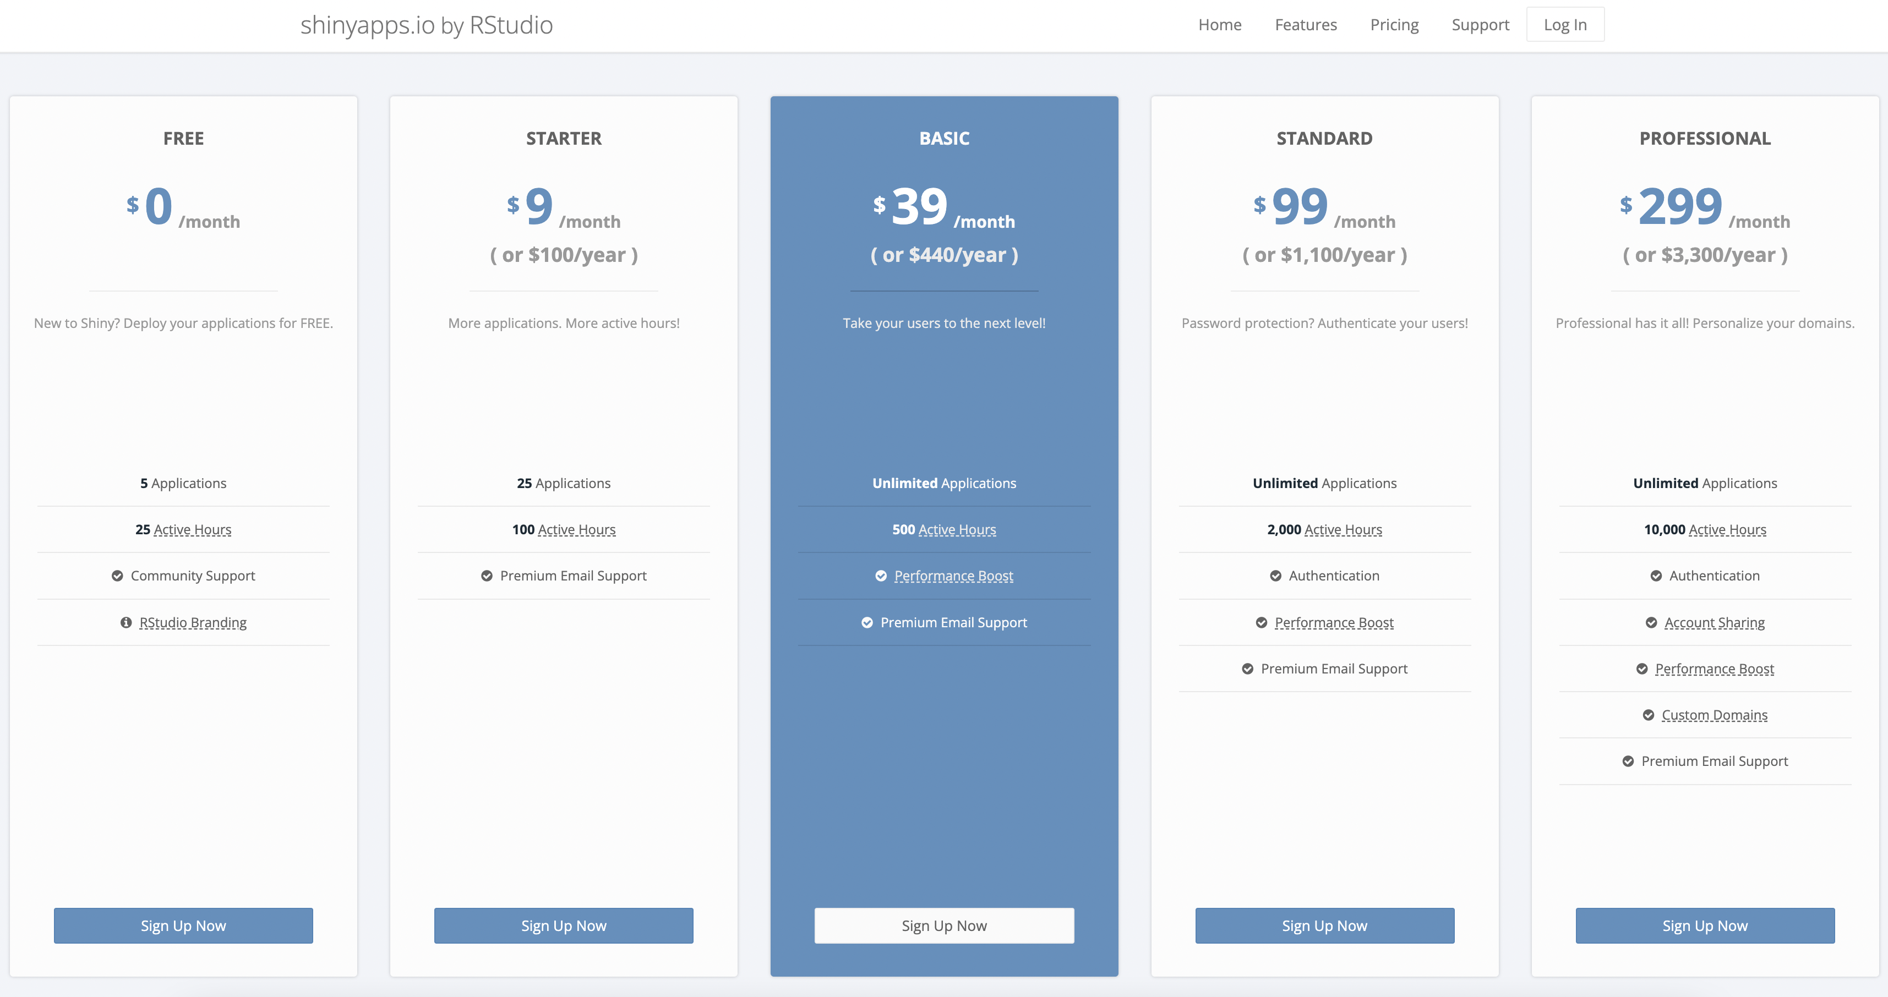
Deploying it on shinyapps.io

Slide 21
Benefits of shiny apps
Expansive interactivity
Great for data that should be presented interactively
Breath and depth of content you can include
A project can have its own web page with multiple pages
Diversity of features
From simple graphs and tables to networks and maps
Works very well with many R packages
Shiny developers are constantly expanding shiny functionality
Open-source and mostly free
Lots of available educational resources, code examples you can use
Very active global community of R Shiny users and annual Shiny contests

Slide 22
“Costs” of shiny apps
Requires a basic-intermediate understanding of coding
Significant time commitment
Restrictions on publishing the app and using it for free
E.g. 25 free user hours/month
Getting to 90% of what you want is easy, the other 10% can take forever
Sadly doesn’t work with all R packages
Things can take a long time to load and process
Depending on the size of your data and what you are visualizing

Slide 23
What do you need to know to build shiny apps?
MUST know:
Making basic and static visualizations in R (e.g. knowledge ggplot2 package)
Cleaning/manipulating your data in R (e.g. knowledge of dplyr, tidyr packages)
Writing out simple Shiny syntax
OPTIONAL but USEFUL to know:
Making interactive visualizations in R (e.g. plotly, chorddiag, visNetwork, tmap packages)
Knowing some html and css to modify various visual aspects of the app
Some prior experience in non-R coding can be helpful (but not necessary)

Slide 24
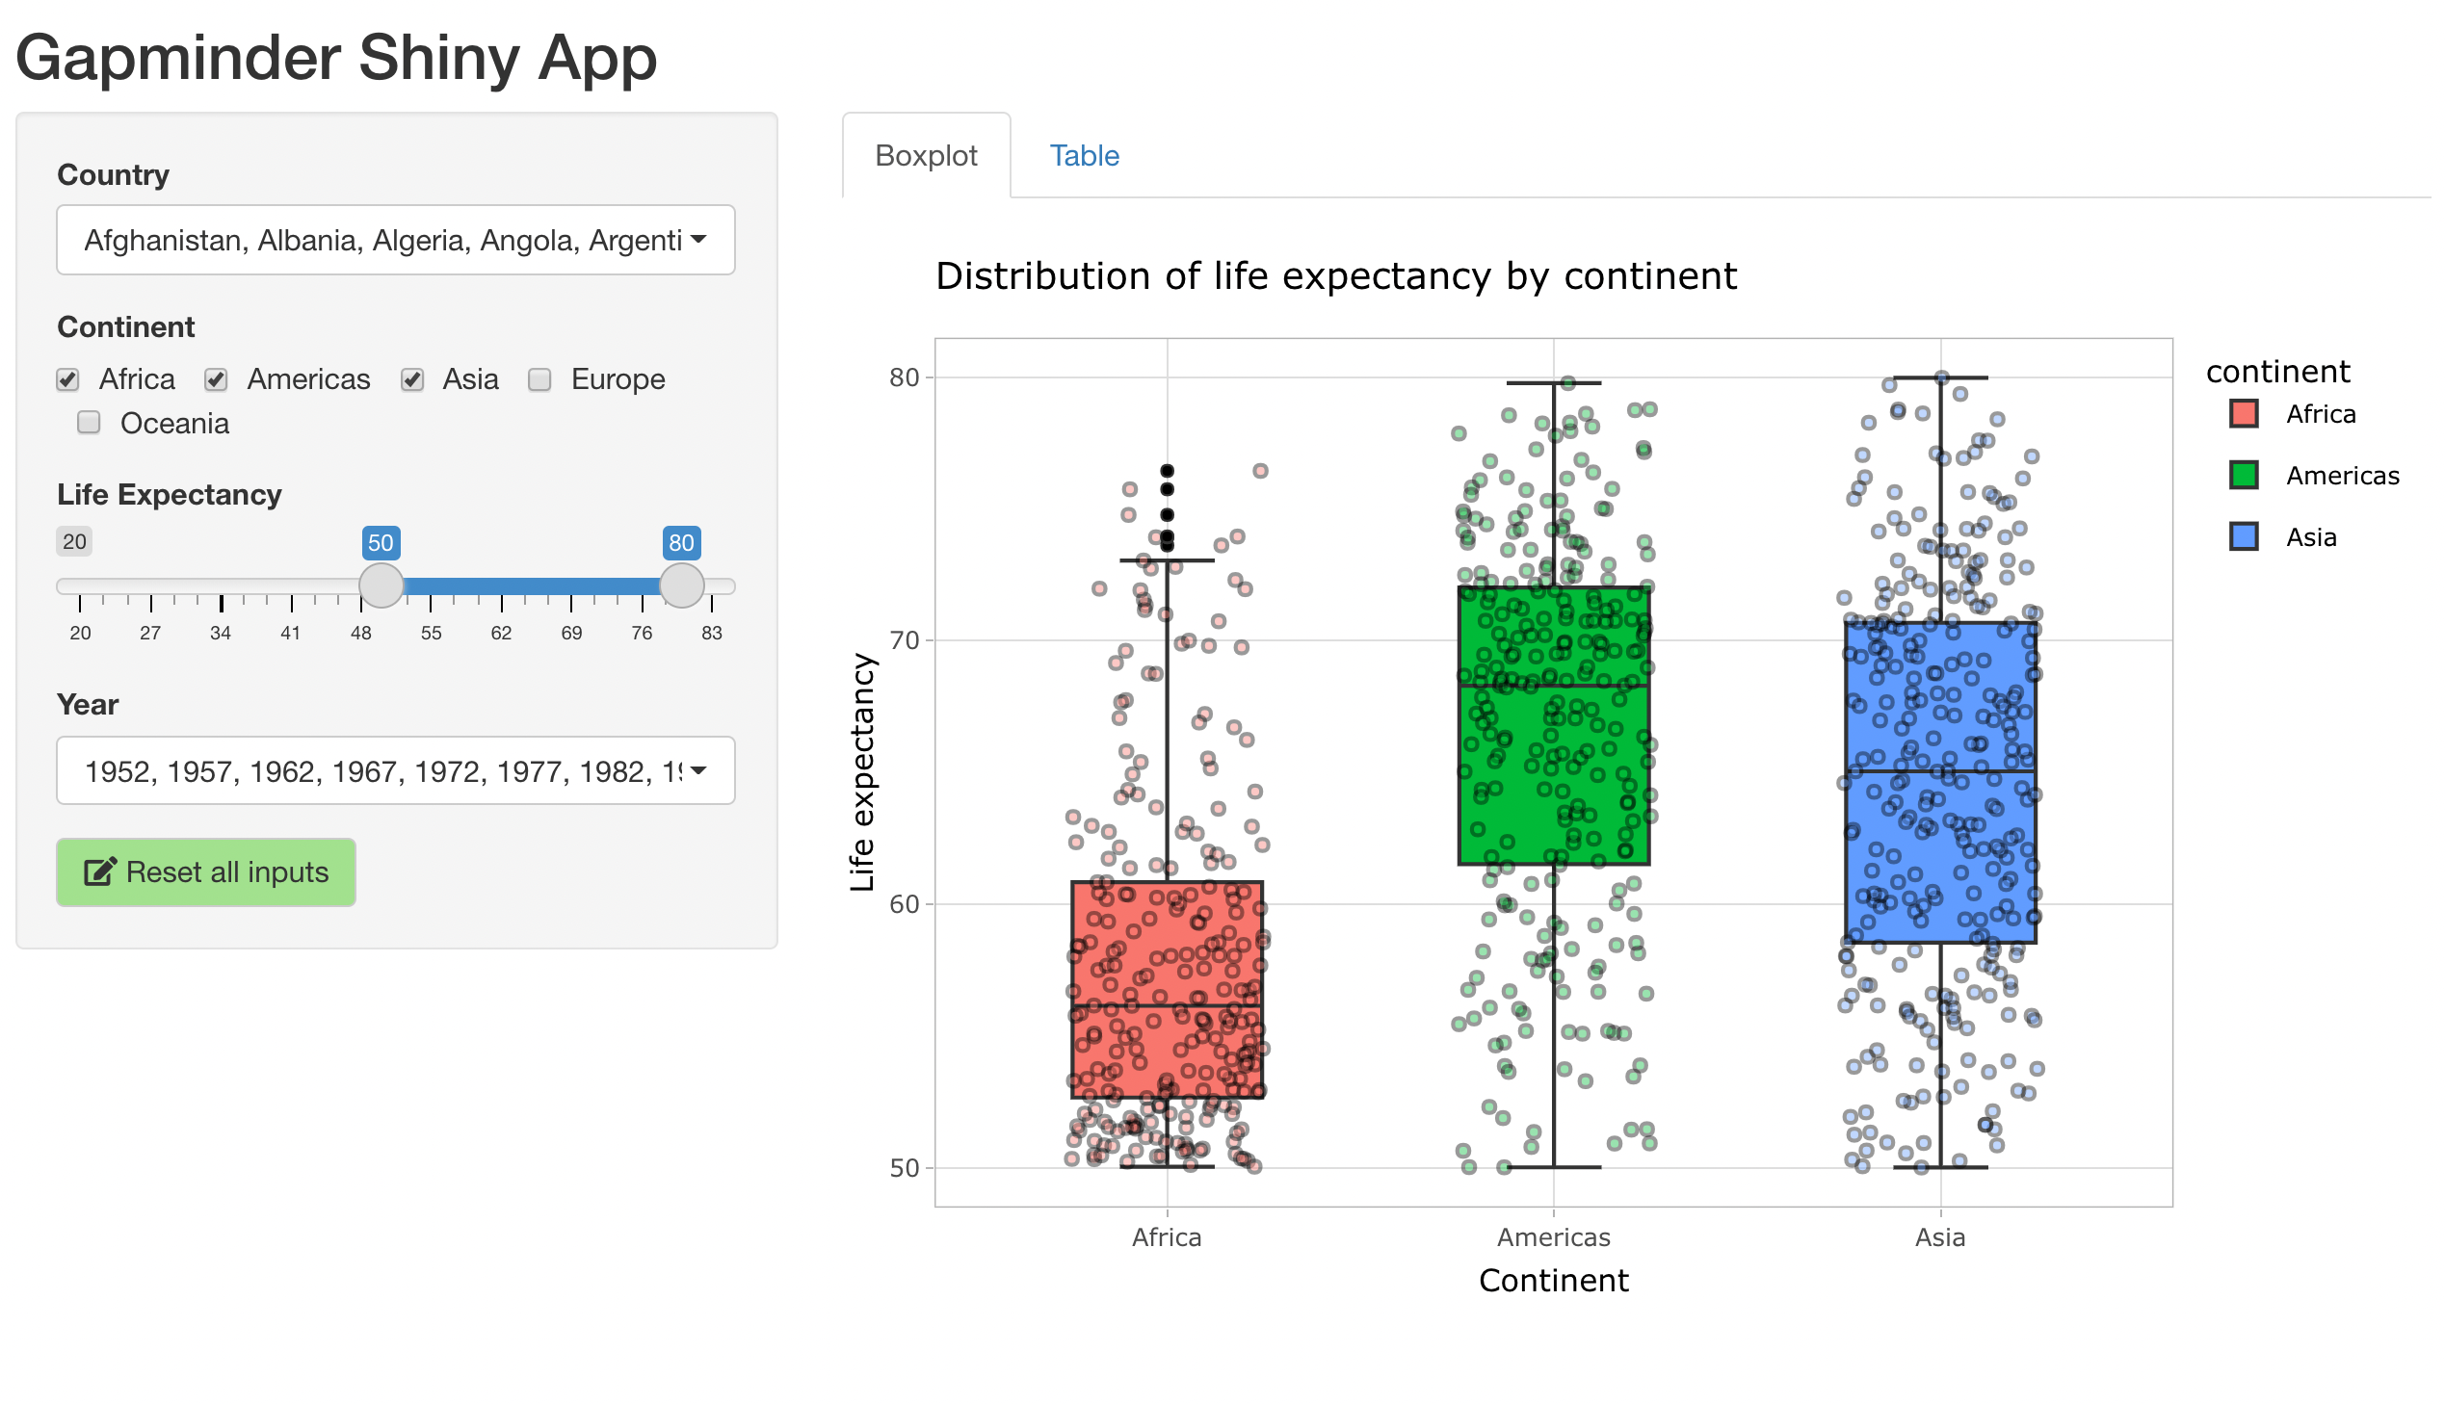
Let’s make our first shiny app!

Slide 25
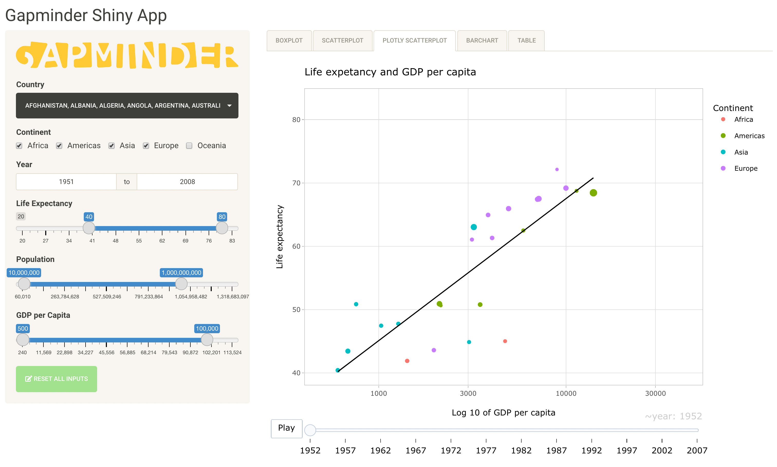
adding more features to our shiny app

Slide 26
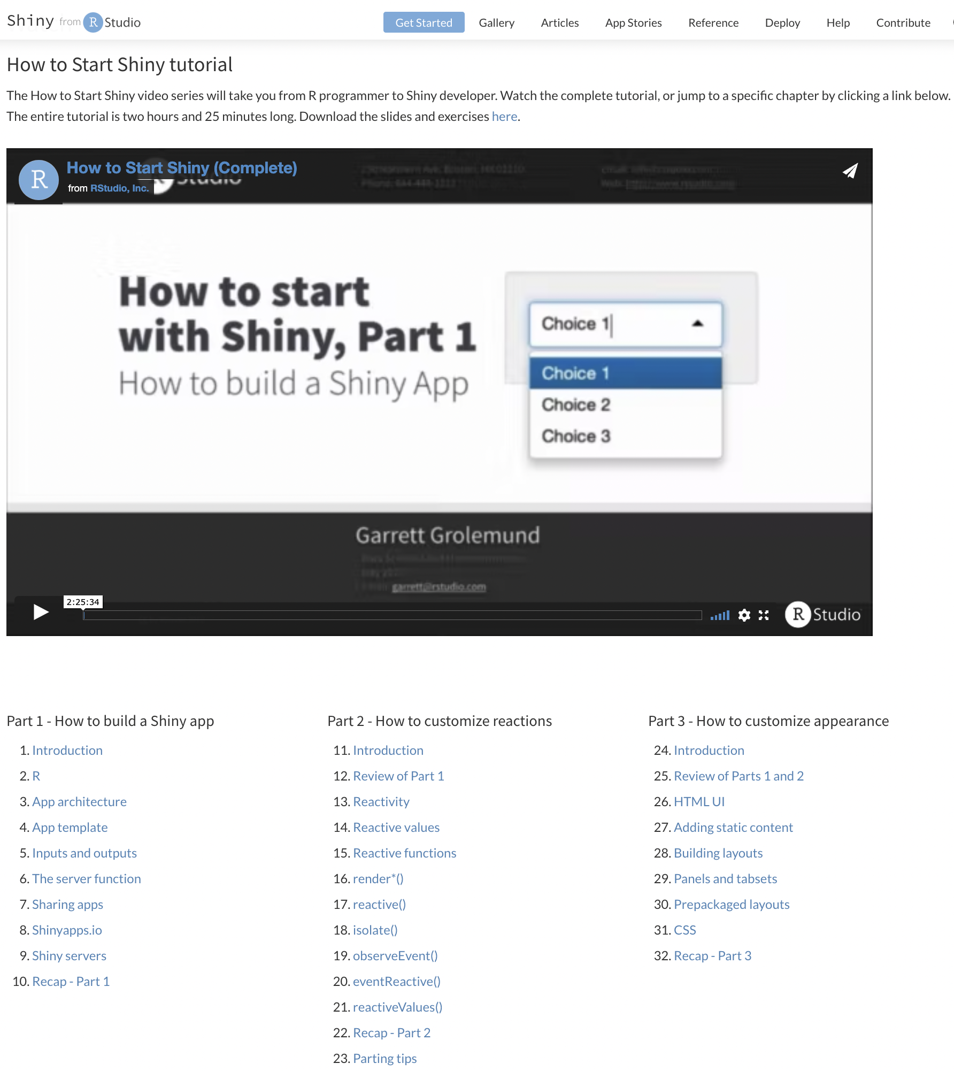
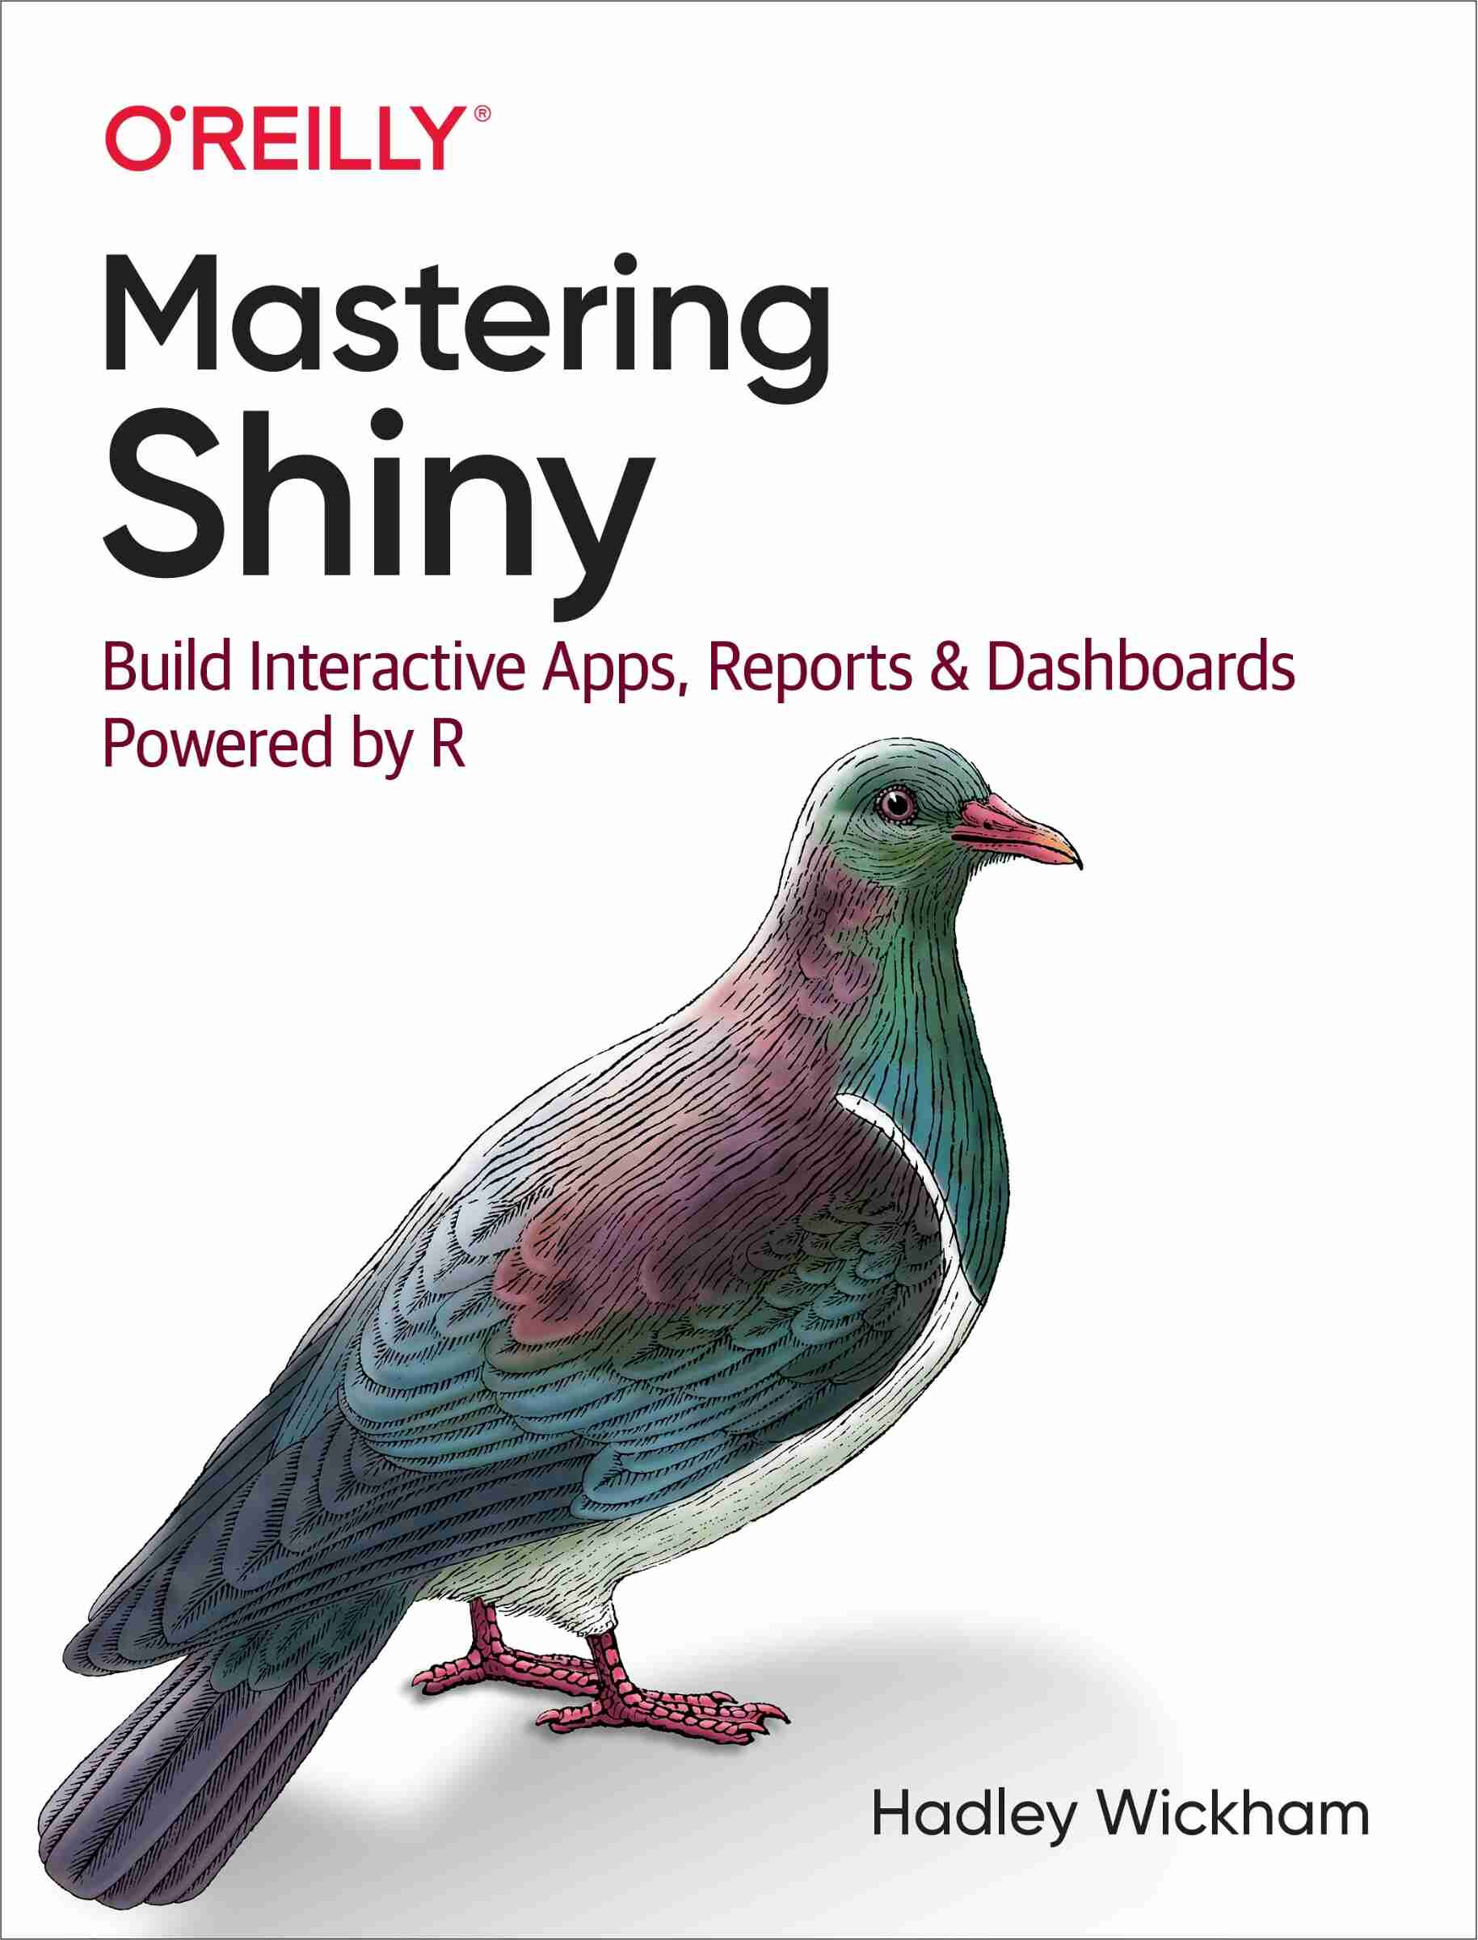
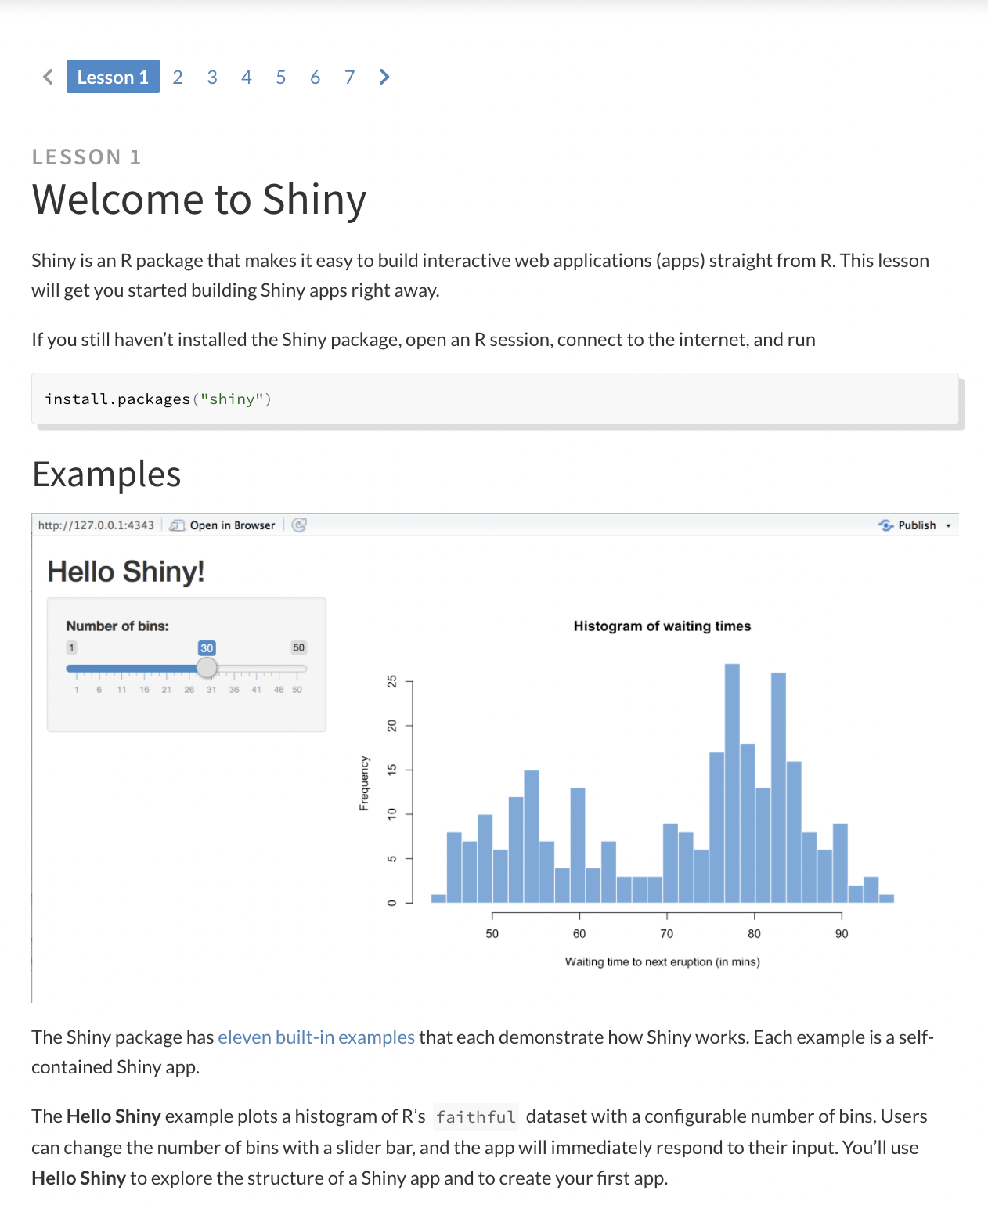
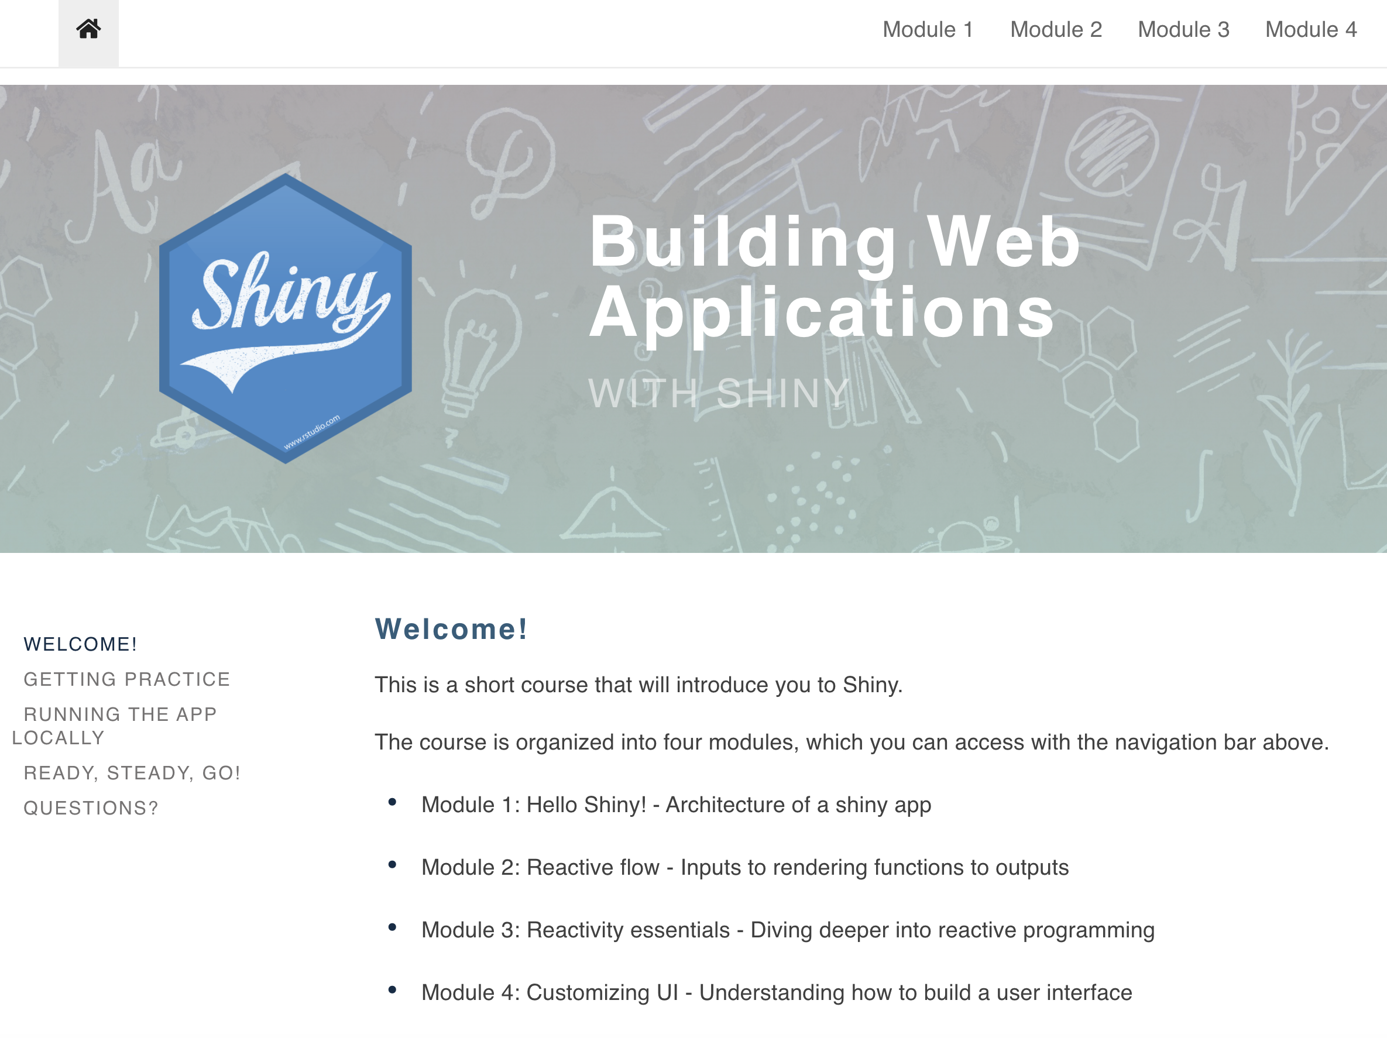
Shiny Resources

Slide 27
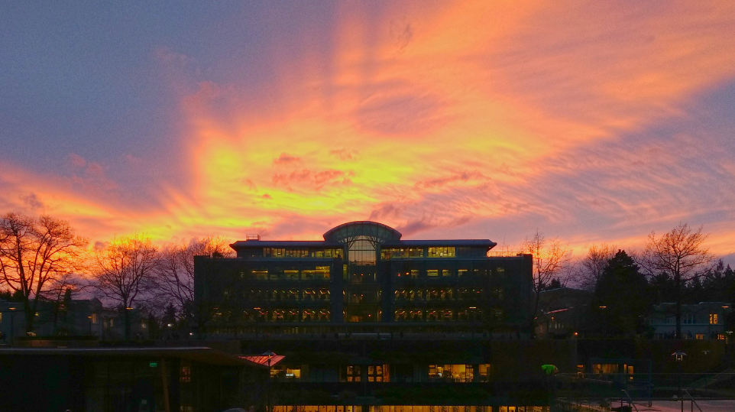
Thank you for Attending!
Please fill out a short feedback survey

